Slide 1


PREDICTING RAINFALL USING MACHINE LEARNING TECHNIQUES
ESTD: 2009
CMR TECHNICAL CAMPUS
UGC AUTONOMOUS
Accredited by NBA & NAAC with ‘A’ Grade
Approved by AICTE, New Delhi and JNTU, Hyderabad
Kandlakoya, Medchal Road, Hyderabad- 501 401, Telangana
S. TEJASRI(217R5A0519)
A. SUMEDHA(207R1A05J2)
CH AKSHAYA(207R1A05K4)
GUIDE :
B.P.DEEPAK KUMAR(ASSISTANT PROFESSOR)

Slide 2
ABSTRACT :
Rainfall prediction is one of the challenging and uncertain tasks which has a significant impact on human society.
Timely and accurate predictions can help to proactively reduce human financial loss.
This study presents a set of experiments which involve the use of prevalent machine learning techniques to build models to predict whether it is going to rain tomorrow or not based on weather data for that particular day in major cities.
This comparative study is conducted concentrating on three aspects: modeling inputs,modelling methods, and pre-processing techniques.
The results provide a comparison of various evaluation metrics of these machine learning techniques and their reliability to predict the rainfall by analyzing the weather data.

Slide 3
EXISTING SYSTEM :
Rainfall prediction is important as heavy rainfall can lead to many disasters.
Rainfall prediction helps people to take preventive measures and moreover the prediction should be accurate.
There are two types of prediction short term rainfall prediction and long term rainfall.
Prediction mostly short term prediction can gives us the accurate result.
The main challenge is to build a model for long term rainfall prediction.
Heavy precipitation prediction could be a major drawback for earth science department because it is closely associated with the economy and lifetime of human.

Slide 4
DISADVANTAGES:
Lack of data: Machine learning algorithms require large amounts of data to be trained effectively. In many regions, historical rainfall data may be limited or incomplete, which could limit the accuracy of the predictions.
Difficulty in feature selection:Identifying the most important variables or features that influence rainfall patterns can be challenging, and different machine learning algorithms may yield different results.
Data quality: Machine learning models are only as good as the data they are trained on. Poor quality data, such as incorrect measurements or biases in the data collection process, can negatively impact the accuracy of the predictions.

Slide 5
PROPOSED SYSTEM :
Proposed system predicts rainfall for the approach which is more accurate.
Accuracy of rainfall statement has importance for countries like India whose economy is basically dependent on agriculture.
Rainfall prediction of precipitation using machine learning techniques may use regression.
Intention of this project is to offer non-experts easy access to the techniques study among the various machine learning techniques.

Slide 6
ADVANTAGES:
Better accuracy: Machine learning algorithms can analyze large amounts of data and identify patterns that may not be obvious to human analysts. This can lead to more accurate predictions of rainfall, which can be beneficial for farmers, hydrologists, and other professionals who rely on this information.
Timely predictions: Machine learning algorithms can process data quickly and generate predictions in real-time or near real-time. This can be useful in situations where timely decisions need to be made, such as predicting floods or planning irrigation schedules.
Scalability: Machine learning algorithms can be trained on large datasets and can be easily scaled to accommodate more data as it becomes available. This can help to improve the accuracy of predictions over time.

Slide 7
HARDWARE REQUIREMENTS: • System : minimum i3 processor. • Hard Disk : 120 GB. • Ram : 16 GB.
SOFTWARE REQUIREMENTS:
• Operating System : Windows 8
• Coding Language : Python 3.7

Slide 8
NOVALITY:
The novality of this project is advancements in machine learning algorithms and the availability of large amounts of data have led to more accurate and reliable predictions.
Machine learning algorithms can help to identify patterns and relationships between different variables, such as temperature, humidity, wind speed, and pressure, that can affect rainfall.
Rainfall prediction using machine learning has numerous applications, including agriculture, hydrology, and disaster management. By providing accurate and timely predictions, machine learning can help to minimize the impact of extreme weather events and improve the management of water resources.

Slide 9
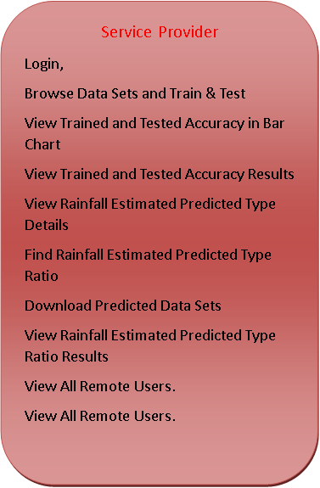



Architecture Diagram
Accepting all Information
Datasets Results Storage
Accessing Data
Process all user queries
Store and retrievals
REGISTER AND LOGIN,
PREDICT RAINFALL ESTIMATE PREDICTION TYPE,
VIEW YOUR PROFILE.

Slide 10
Modules
Remote User
Service provider
Views And Authorize Users

Slide 11
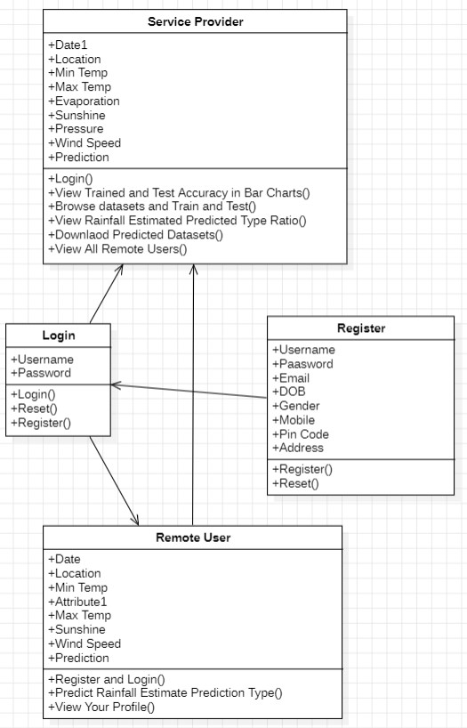
Class Diagram

Slide 12
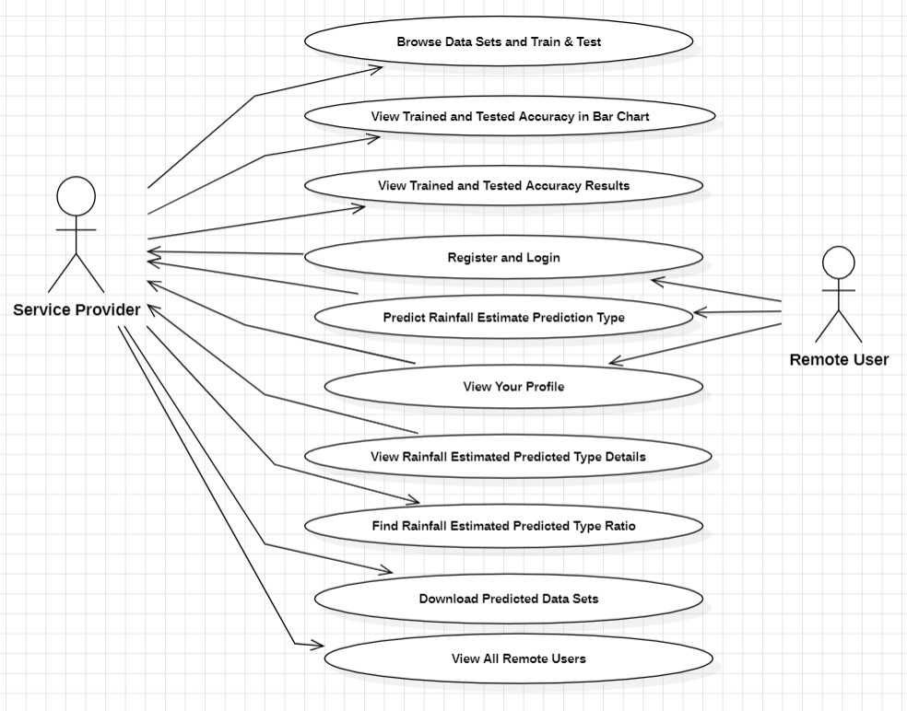
Use Case Diagram

Slide 13
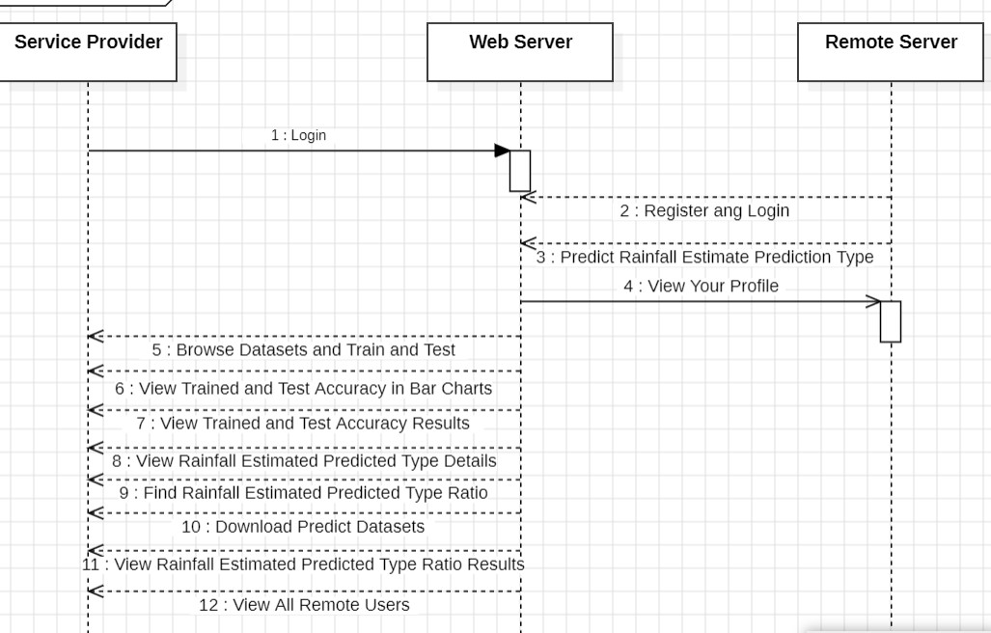
Sequence Diagram

Slide 14
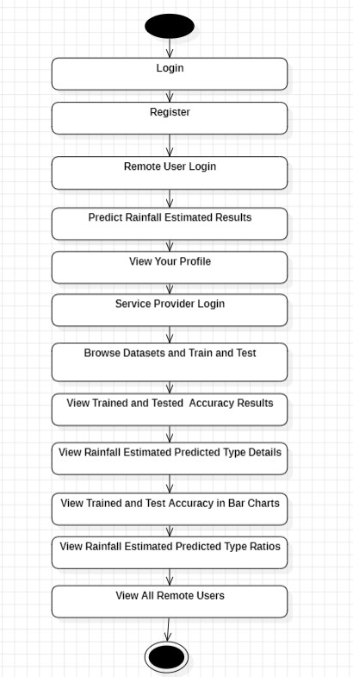
Activity Diagram

Slide 15
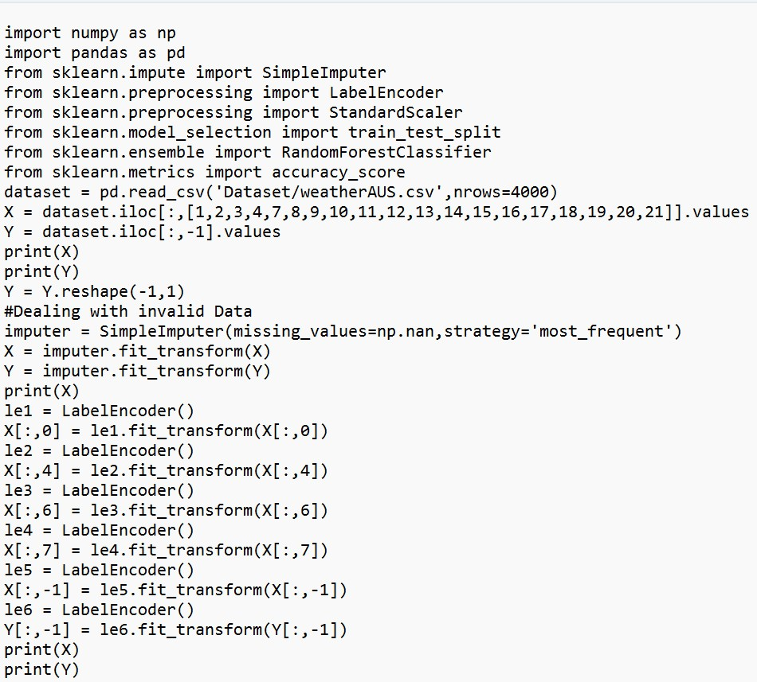
Sample code

Slide 17
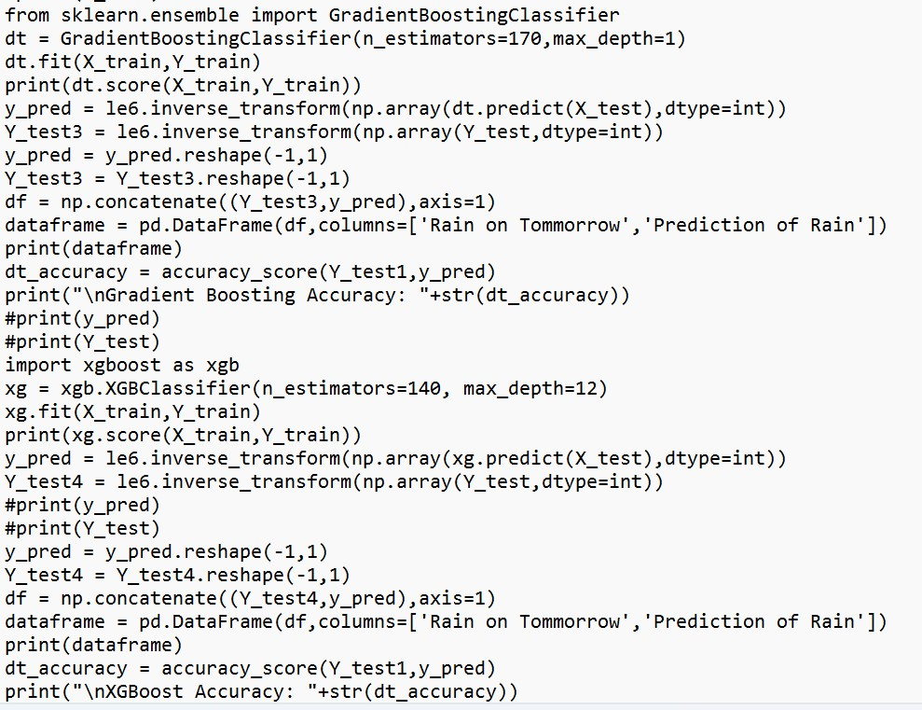

Slide 18

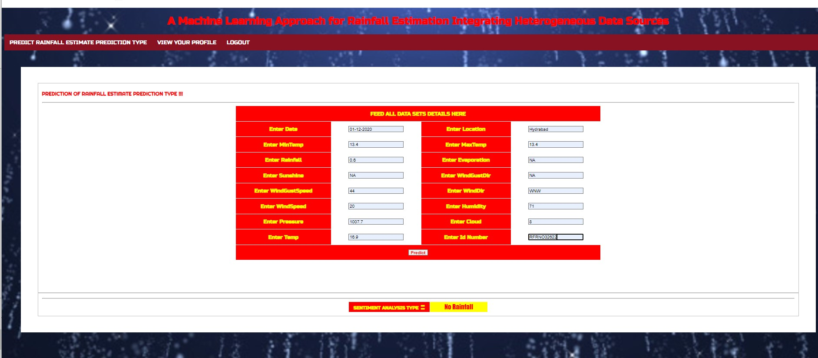
RESULT:

Slide 19

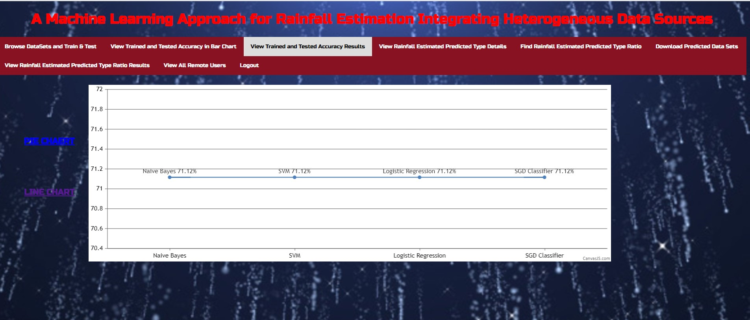

Slide 20
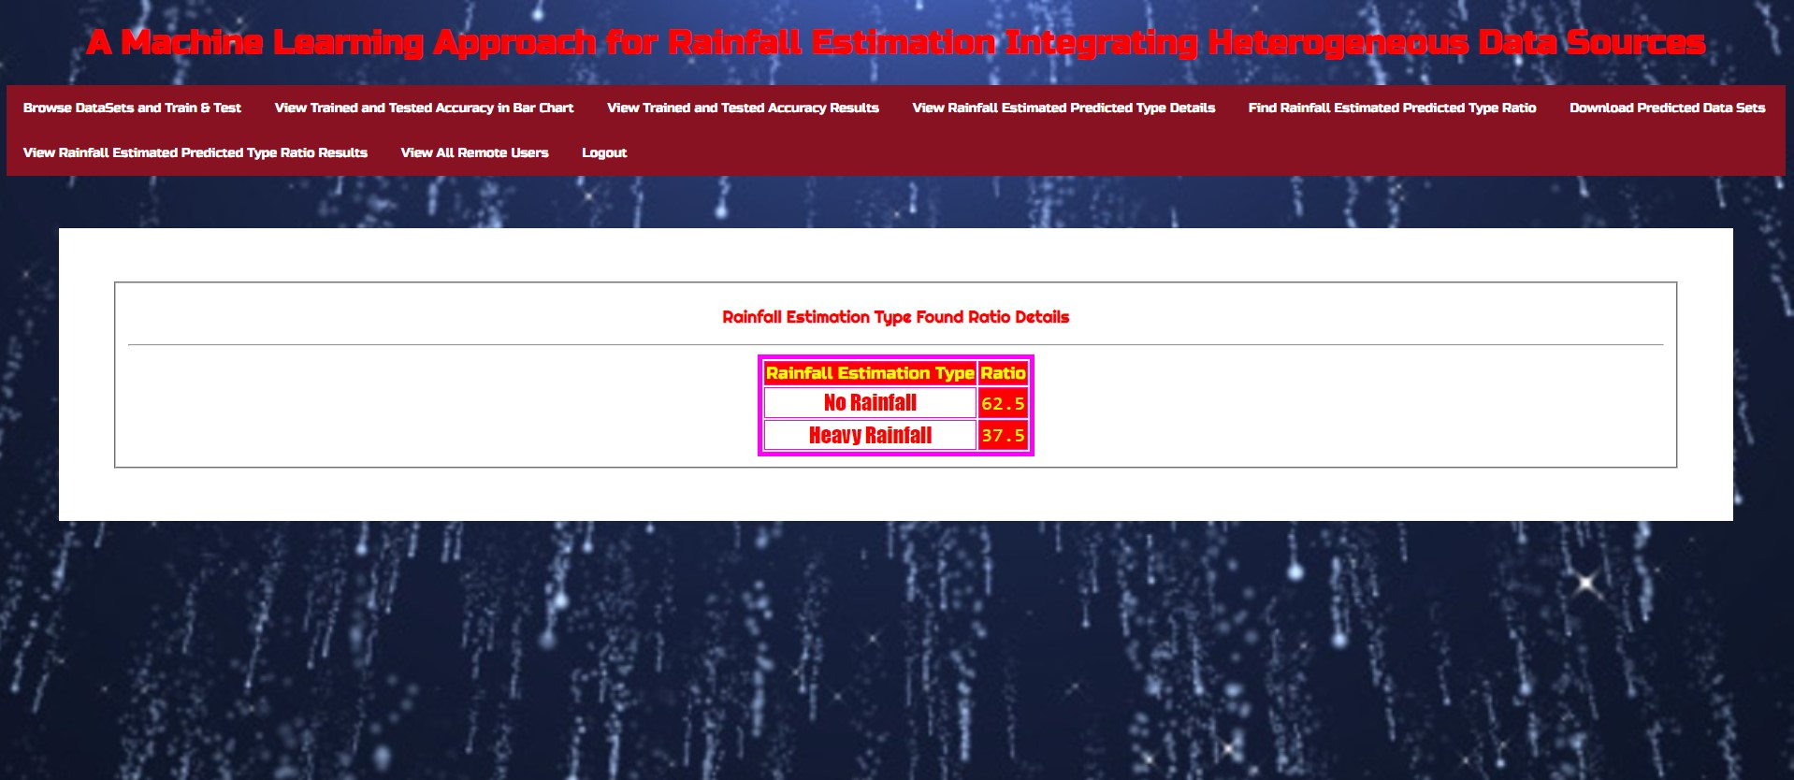
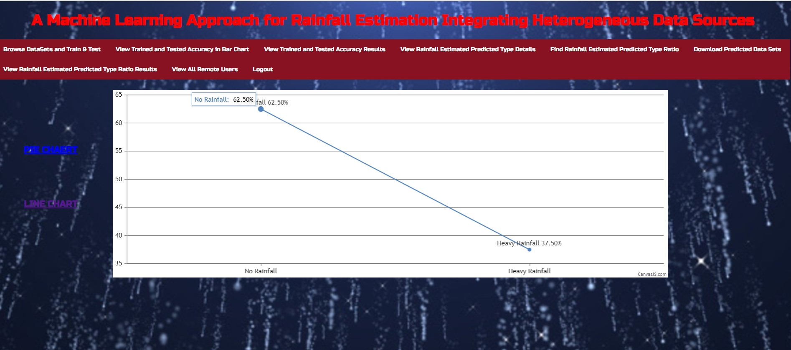

Slide 21
REFERENCE:
J. E. Ball and K. C. Luk, “Modeling spatial variability of rainfall over a catchment,” J. Hydrologic Eng., vol. 3, no. 2, pp. 122–130, Apr. 1998.
H. S.Wheater et al., “Spatial-temporal rainfall fields: Modelling and statistical aspects,” Hydrol.E.arth Syst. Sci., vol. 4, no. 4, pp. 581–601, Dec. 2000.
H.Wackernagel, Multivariate Geostatistics: An Introduction With Applications. Berlin, Germany: Springer, 2003.
L. Breiman, “Bagging predictors,” Mach. Learn., vol. 24, no. 2, pp. 123–140, Aug. 1996.
Demšar, “Statistical comparisons of classifiers over multiple data sets,” J. Mach. Learn. Res., vol. 7, pp. 1–30, Jan. 2006.

Slide 22
FUTURE SCOPE:
Improved Accuracy and Precision:Future research will likely focus on enhancing the accuracy and precision of rainfall predictions by developing more sophisticated machine learning algorithms and models. This includes the use of deep learning techniques, neural networks, and advanced statistical methods.
Hydrological Integration: Coupling rainfall prediction with hydrological models can improve the understanding of how rainfall affects river flow, reservoir levels, and groundwater recharge. This can aid in more effective water resource management.
Localized Predictions: Developing models for localized rainfall predictions is essential, as rainfall patterns can vary significantly within a region. High-resolution models that consider topography and land-use characteristics can be beneficial.
User-Friendly Applications: Creating user-friendly and accessible applications for farmers, water resource managers, and emergency responders can facilitate the practical use of machine learning-based rainfall predictions.

Slide 23
CONCLUSION:
Machine learning models can be trained on historical data of rainfall patterns to make accurate predictions of future rainfall.
Machine learning for rainfall prediction is that it can take into account a large number of variables, such as temperature, humidity, wind speed, and atmospheric pressure, which can affect rainfall. Machine learning models can also adapt to changing patterns and trends, which can be challenging for traditional statistical models.
Accuracy of the predictions depends on the quality of the input data, the choice of model, and the underlying assumptions and limitations of the model.
Conclusion of project is predicting rainfall has the potential to significantly improve our ability to forecast weather patterns and prepare for extreme weather events.

Slide 24
GITHUB LINK
https://github.com/sheggariTejasri/Predicting-Rainfall-Using-Machine-Learning-Technique.git

Slide 25


